Slide 1
WATER FOR OUR FUTURE POST 7WWF
WATER SECURITY & SUSTAINABLE GROWTH
Dewan Baiduri, Wisma Sumber Asli, PutraJaya
06102015
Kalithasan Kailasam

Slide 2
Water for Our Future :Thematic Framework
Thematic Process Session
Theme 1, 2 & 3
ACTION GOALS – The Future We Want
Water Security for All
Water for Development & Prosperity
Water for Sustainable : Harmonizing Human & Nature

Slide 3
Theme 1. Water Security For All
Enough Safe Water for All
Integrated Sanitation for All
Adapting to Change Managing Risk & Uncertainty for Resilience & Disaster Preparedness
Infrastructure for sustainable water resource management & services
Since recognition of Human Right to Water & Sanitation by the UN in2010, focus has been placed on implementation measures to make that right a reality on the ground, as measured by quality, quantity, affordability and equity.

Slide 4
Theme 2. Water for Development & Prosperity
Water for Food
70% of the world’s water withdrawals – used for agriculture
Water for Energy
Ensuring water security while managing the rapidly growing demand for energy is a major challenge
Water for Cities
Better management of urban water services will reduce poverty in city,
Better protection of water sources will make cities more resilient

Slide 5
Theme 3. Water for sustainability : harmonizing humans & nature
Green growth, Water stewardship & Industry
Managing & restoring ecosystems for water services & Biodiversity
Ensuring water quality from ridge to reef
SMART Implementation of IWRM
Water for sustainability : harmonizing humans & nature. The water cycle in at the center of our ecological support system for life and restoring watersheds improve both the sustainability of water services and the conservation of biodiversity

Slide 6
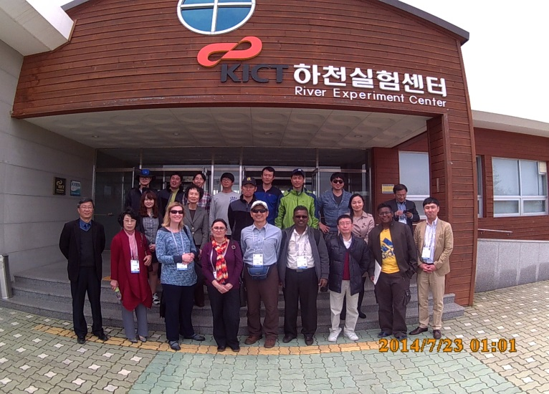
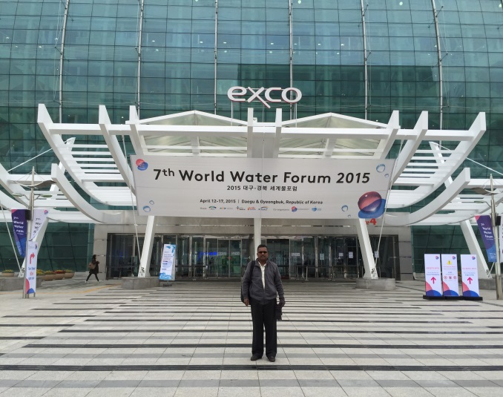
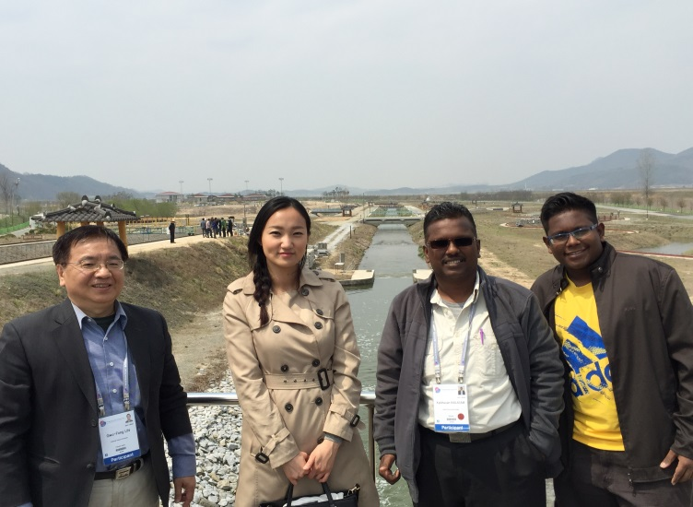
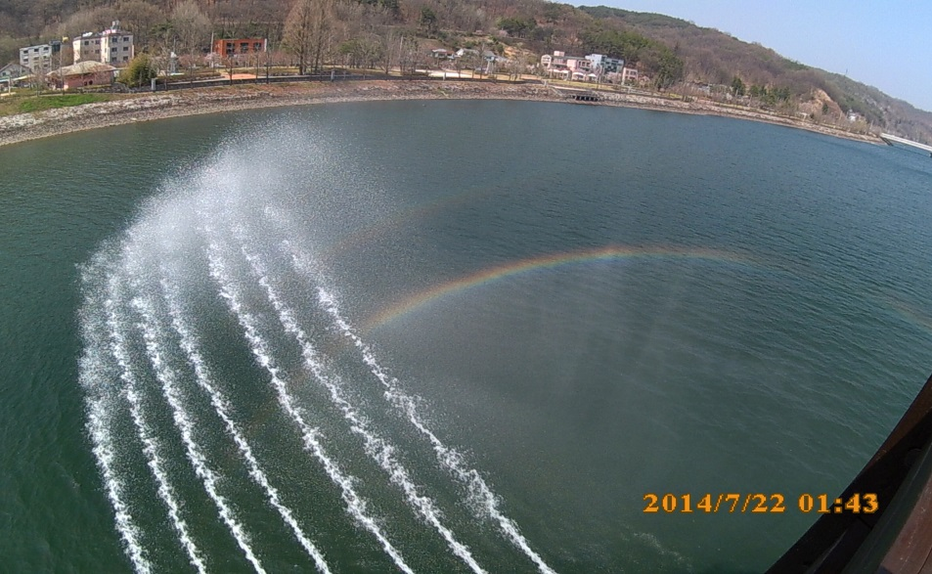
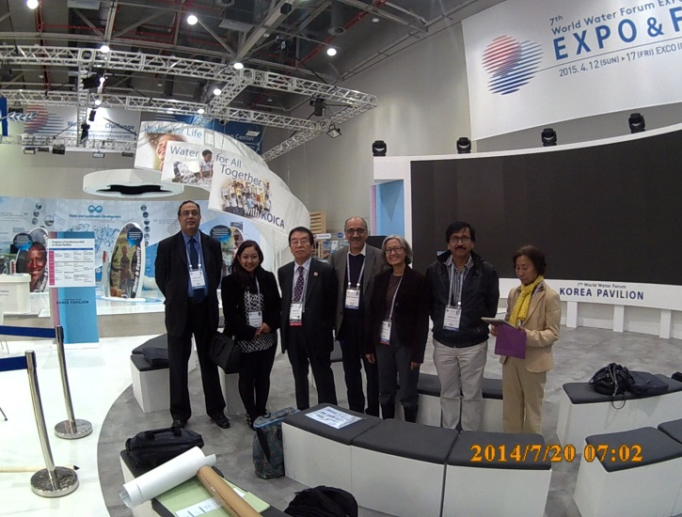
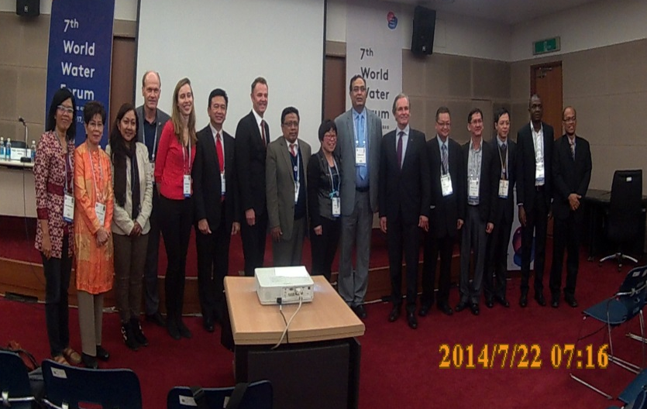
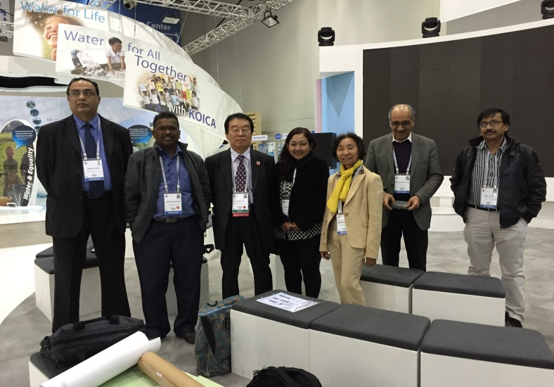

Slide 7
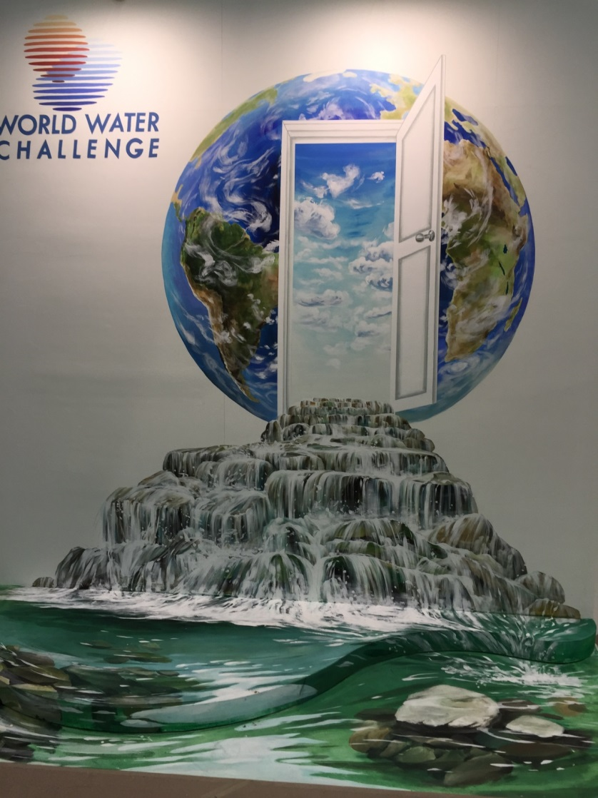
KEY MESSAGES

Slide 8
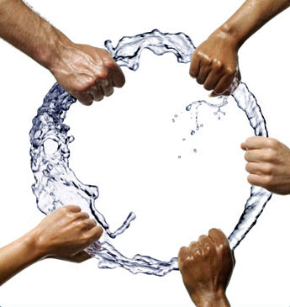
1. Water Security
Key indicators of water security risks:
Water Scarcity;
Floods;
Inadequate Water Supply and Sanitation;
Ecosystem Degradation and Pollution.
Quality
Quantity
Affordability
Equity
Implementation measurement to make the water security on the ground :

Slide 9
2. Water Security : Risk or Opportunity
Narratives
or
Water challenges present opportunities rather than merely a threat
Technological, economical & social innovations, & business too!

Slide 11
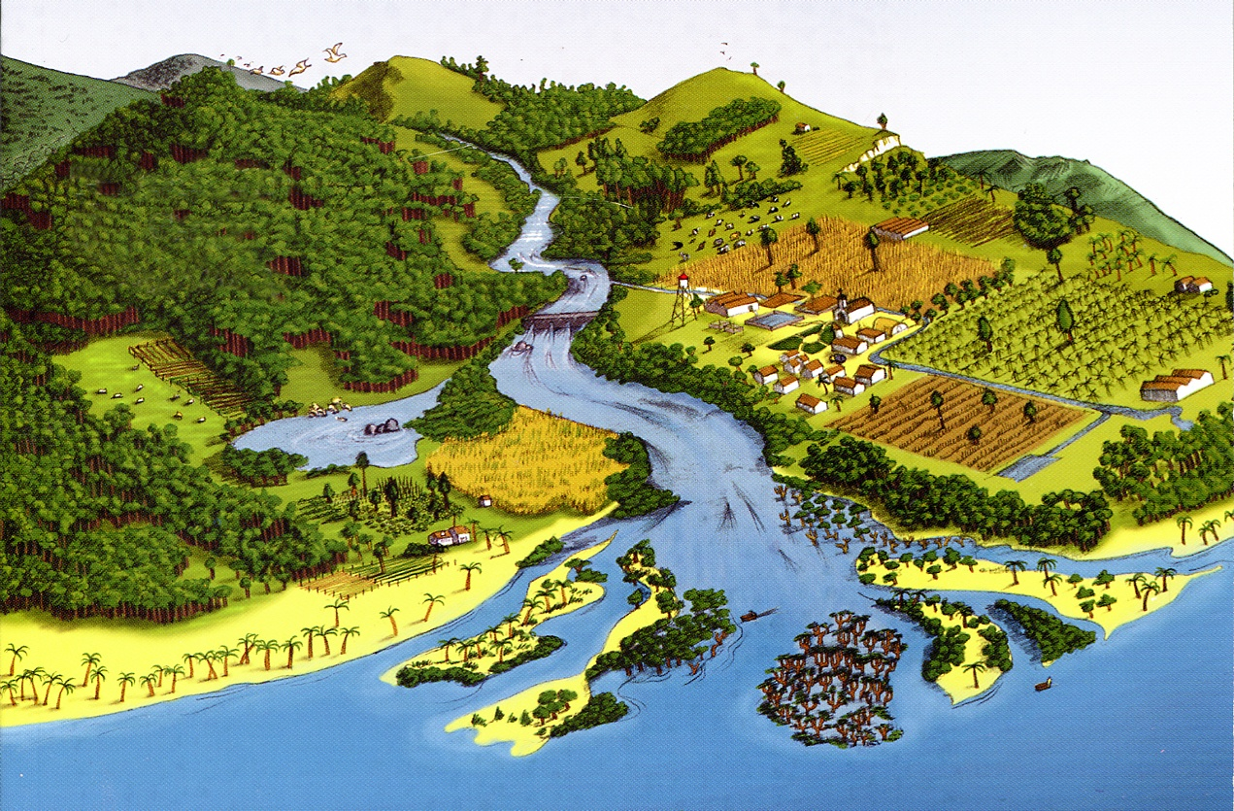
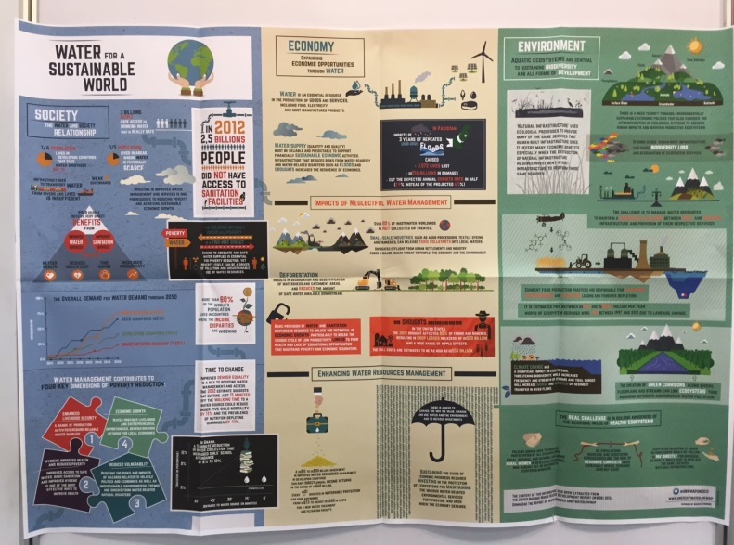
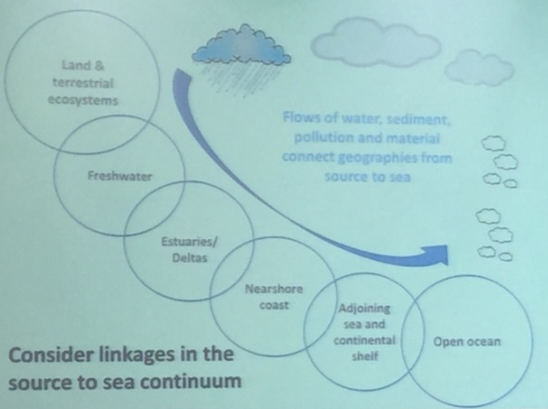
3. Holistic Approach (bigger picture)
2Ss (Source to Sea)
2Rs (Ridge to Reef)
Actors from land, rivers, coast and sea have to work have to work together
Sustainable growth can be encourage by bridging
Economic, Social & Environmental dimensions of water

Slide 12
4. The ABC for Sustainable
ACCESS
BEHAVIOUR
CAPITAL
provide access to safe drinking water & sanitation
use social arts in connection with water & sanitation to raise awareness, mobilize communities and impact behaviours
offer microloans to support local production, increase financial inclusion and improve the economic well-being of communities

Slide 13
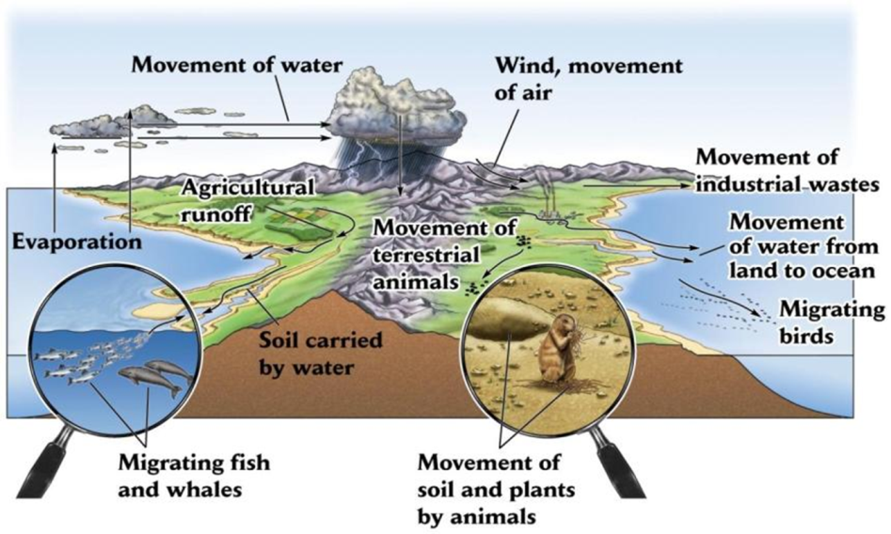
5. Connectivity (vs Integration)
All are inter-connected
So the best will be how to connect
Within & Between
Sectors &/or Stakeholders

Slide 14
Others
Pathways to water security and sustainable growth are dynamic
Science & Technology
Innovation
Offer significantly acceleration in progress: solving local, regional & global water problems
Science & Policy
Should work more closely together for better governance.
Business/Economy
Investment (Need Re-thinking)
No shortage of capital (but do need to better define beneficiaries)
Greater recognition is needed for the contribution of investment in water infrastructures and services to create platforms for growth & social stability.
Payment for Ecosystem Services (PES)
Another powerful reason for society to look after the natural world, and stop taking for granted the benefits we derive from it.

Slide 15
Others
Smart Partnership
Partnering with an international operator to improve specific services
also local experts
New partnerships between academia, governments, business and civil society
Sharing
Expertise
Knowledge & innovation
Water Education & Capacity Building
ESD & Post 2015
Higher Education
K12 & Youth
Community education
Water & Gender Equality

Slide 16
IHP – VIII : Water Security Putting Science into Action

Slide 17
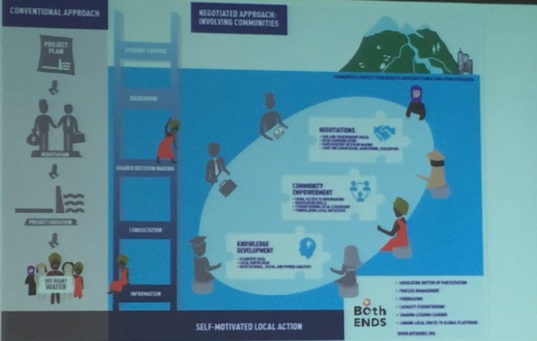
WAY FORWARD 8WWF
From Vision to Action
Local Action for a Global Challenge
JUST DO IT !!

Slide 18
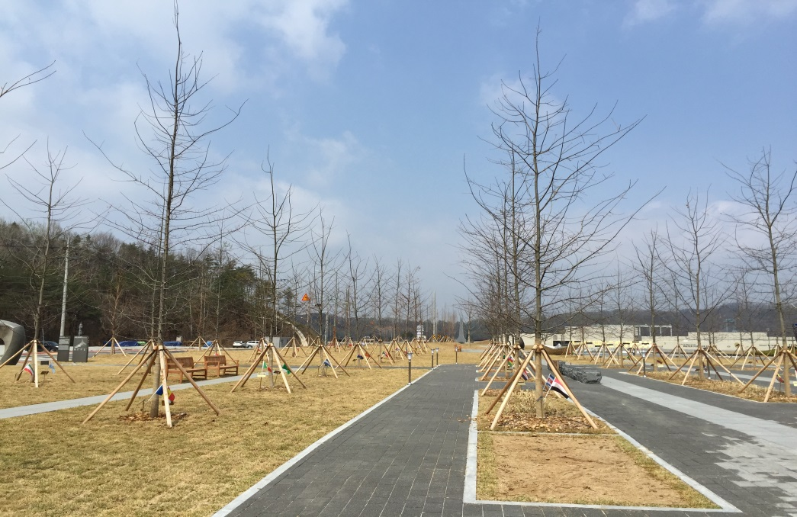
TERIMA KASIH

